Slide 1
Rose Sale Fundraiser

Slide 2
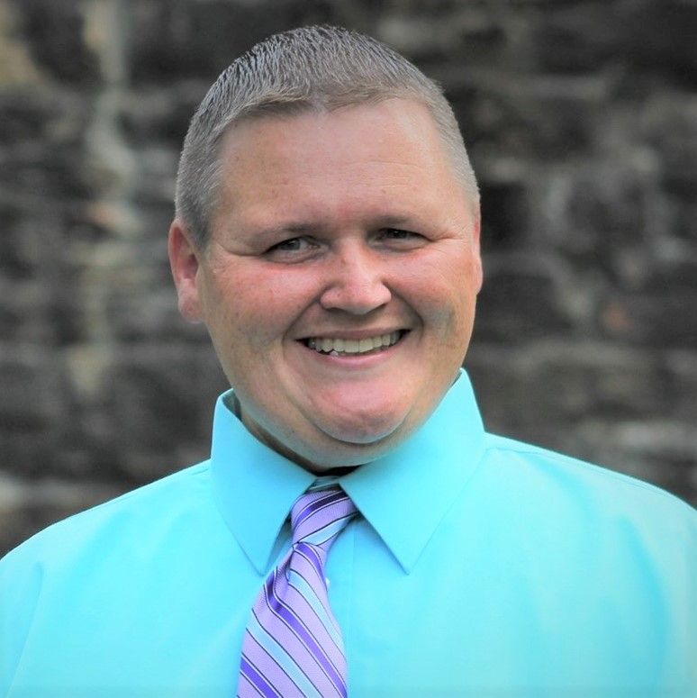
Welcome from Pennsylvania Kiwanis Foundation
Emily Reed Brian Root

Slide 3
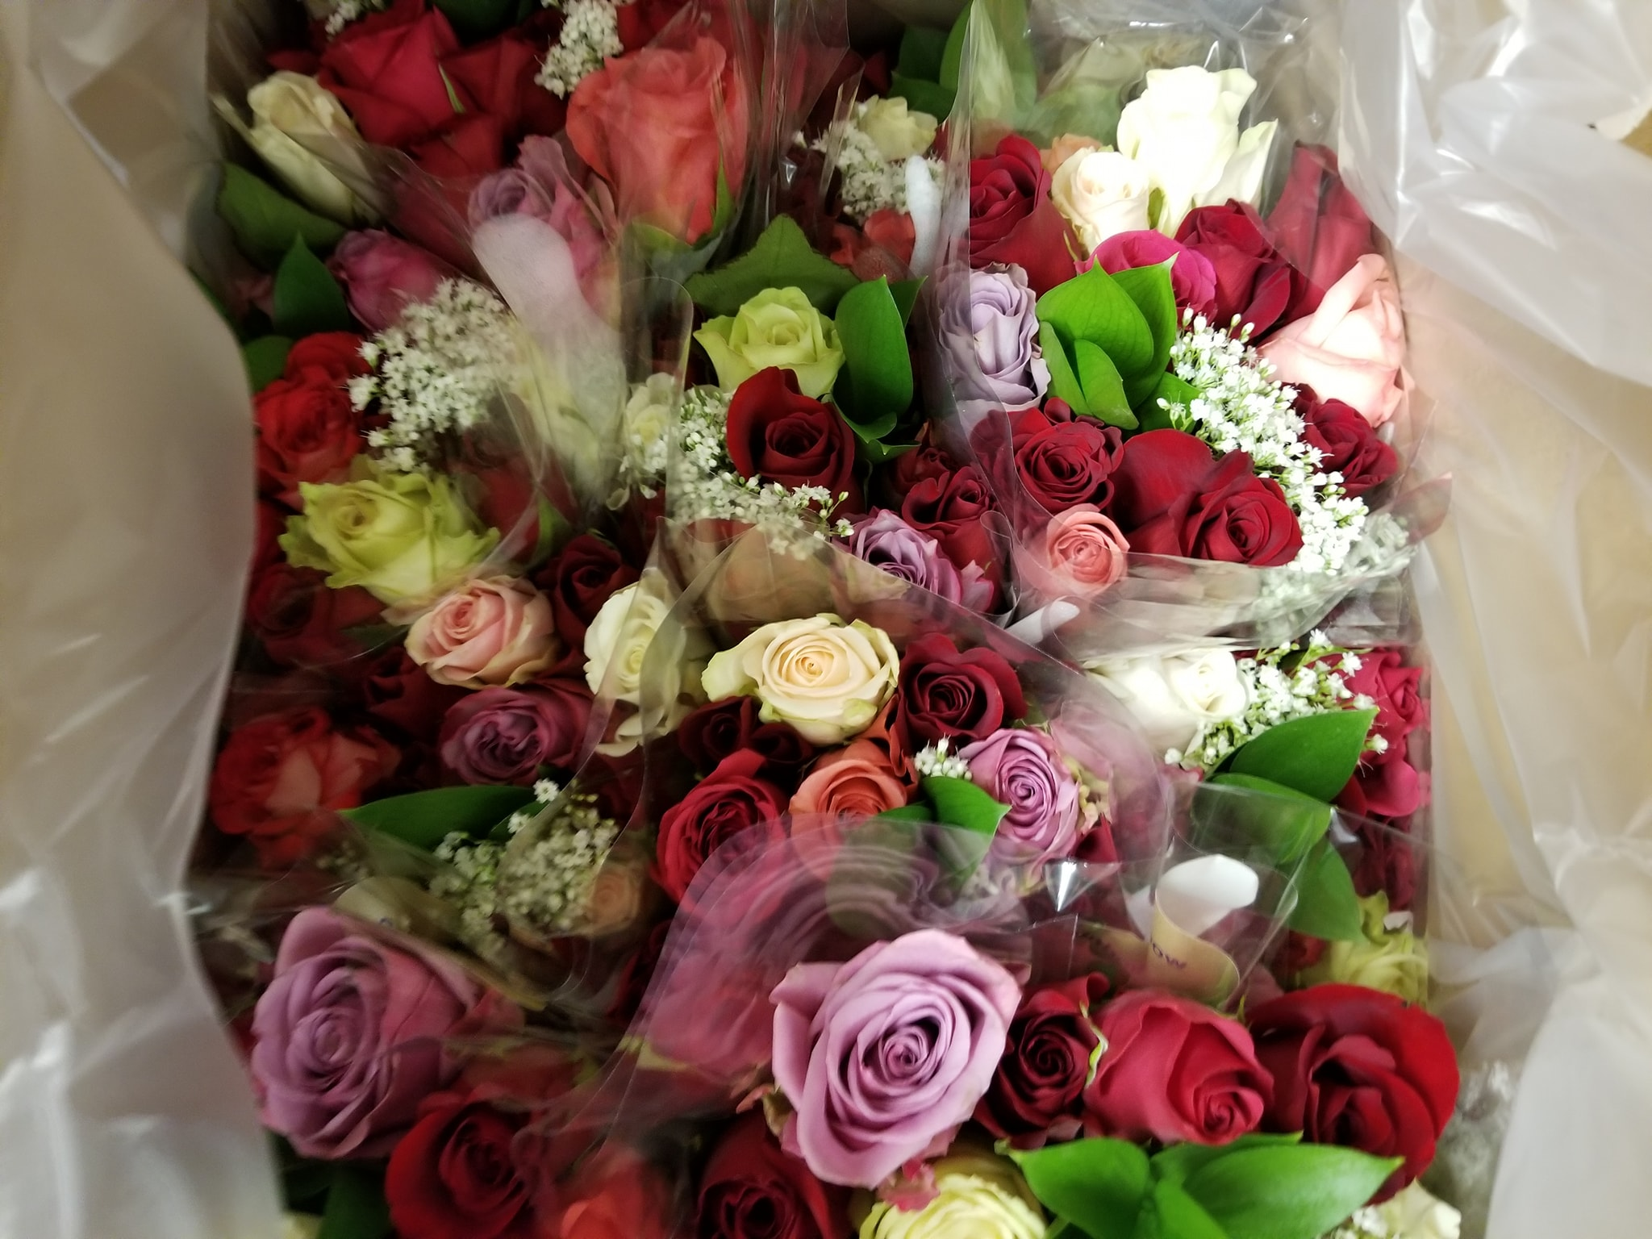
Details of Roses
Quality long stemmed roses of mixed colors
Includes ferns and baby’s breath

Slide 4
Rose Sale Profit
1 dozen roses= sold for $24.00
Kiwanis clubs= $9.50 profit on each dozen
PKF= $4 on each dozen

Slide 5
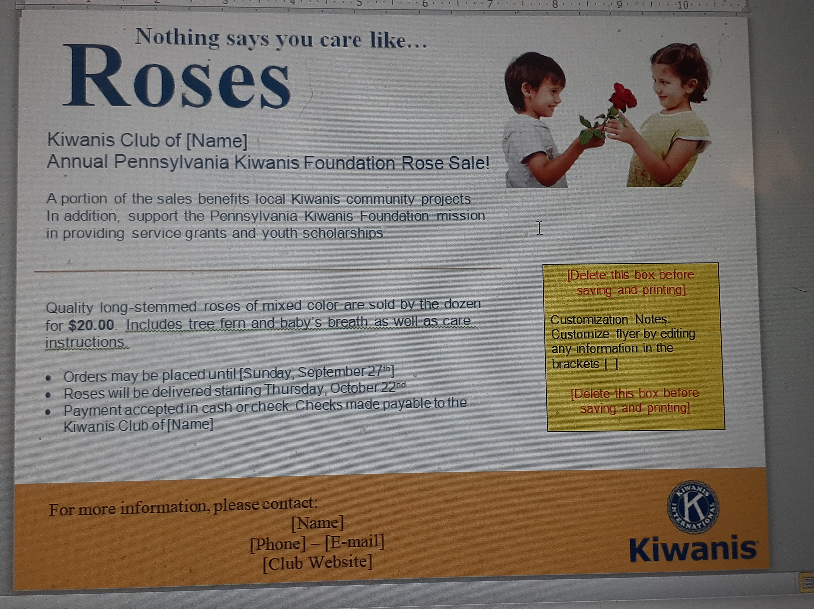
Marketing Materials
Customizable marketing poster
Individual
member order form
Club order form

Slide 6
Rose Sale Timeline
July/August
Assign a Rose Sale Coordinator
Download marketing materials
Advertise: Facebook, club website, local community

Slide 7
Rose Sale Timeline
August/September
Rose sale begins
Checks should be payable to your Kiwanis Club
Orders due on Friday, September 29th

Slide 8
Rose Sale Orders
September/October
Use Rose Sale Order Form on website to collect orders
Orders due Online by Friday, September 29th
Click on link called Rose Sale Final Online Order Form/Square Checkout Link to place FINAL ORDER

Slide 9
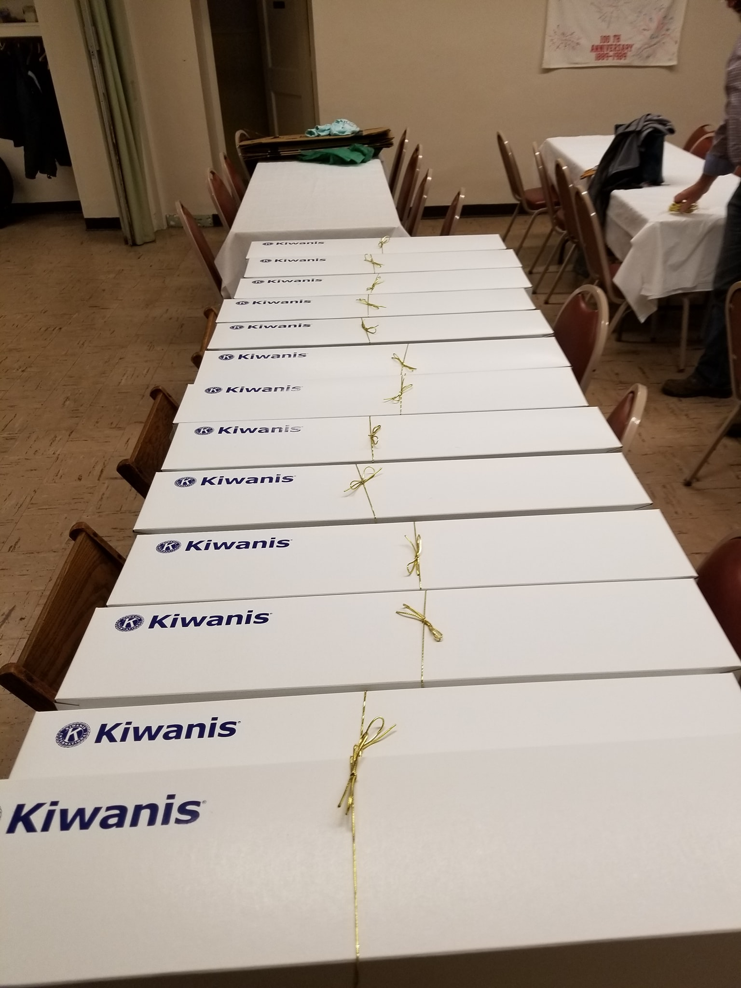
Rose Sale Timeline
October
Clubs will be contacted by Zieger and Sons for delivery schedule
Rose sale delivered on Thursday, October 26, 2023
Assemble your roses and distribute to purchasers

Slide 10
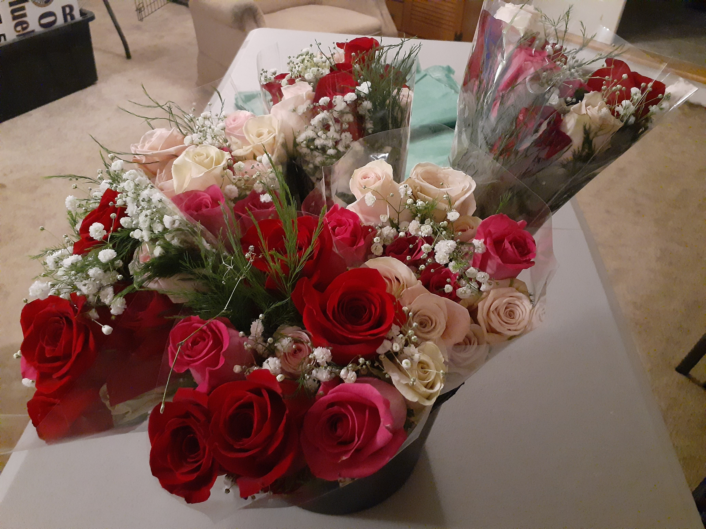
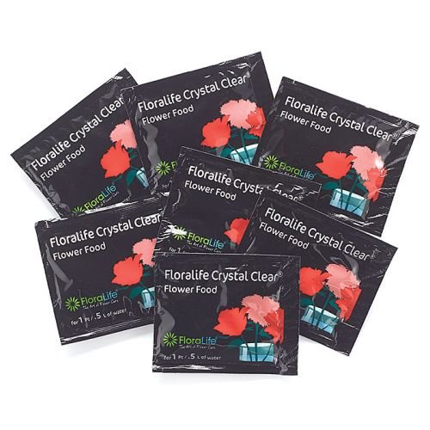
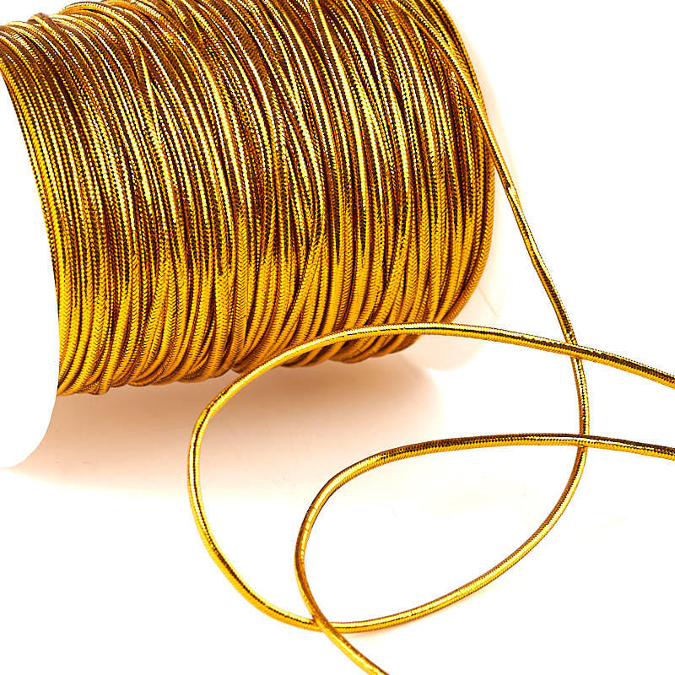
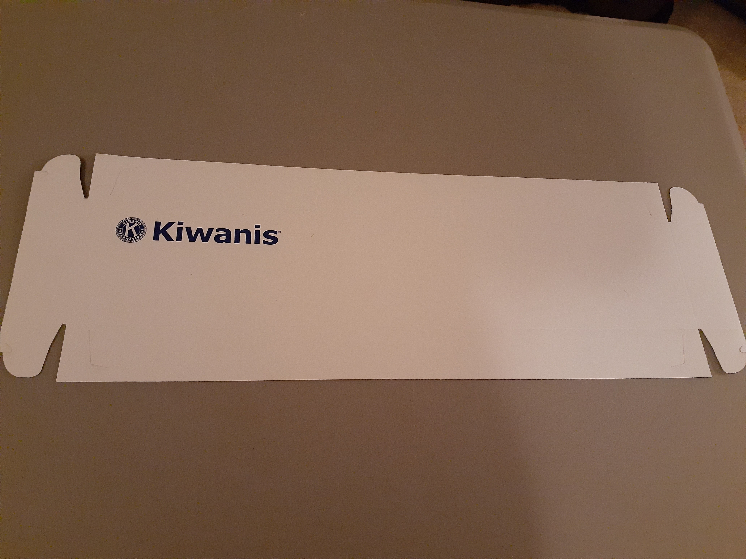
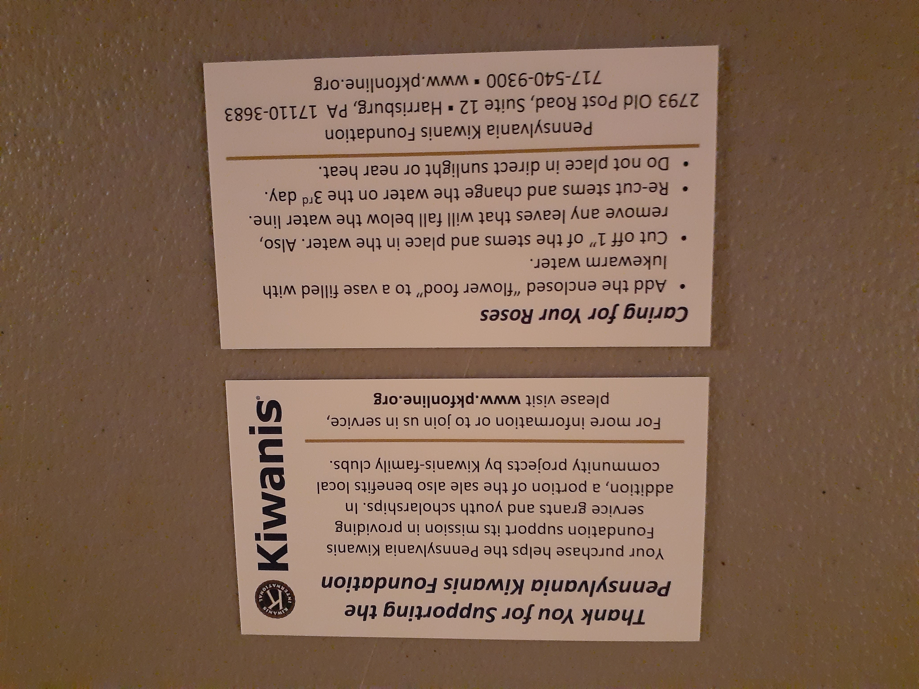
Assembling Your Roses

Slide 11
Assembling Your Roses
Put together boxes, add Kiwanis sticker to lid
Remove roses from plastic
Wipe stems with rag
Place tissue paper in box
Place six roses facing one direction, six roses facing opposite direction
Fold tissue paper over roses
Place PKF Thank you on top (add club flyer if you wish)
Close the box and attach gold band
Recommendations from the rose distributer

Slide 12
Covid-19
Florist: roses are from Central/South America
They have had no issues and have been following CDC regulations
Clubs for distribution: can easily pack and distribute while following CDC regulations, social distancing, etc.

Slide 13
Rose Sale Tips
Establish a club goal
Consider buying additional roses to allow for extra sales past deadline
Get your Service Leadership Programs involved
Final order must be in increments of 10 dozen

Slide 14
Early Learning Program
Clubs will apply by presenting an Early Learning project
Clubs will receive up to $500 toward their project

Slide 15
Thank You
By participating….
Your clubs will help PKF be able to provide grants and scholarships

Slide 16
Questions
Questions?
Contact at any time…
rosesale@pkfonline.org

